Slide 1
LOAN BOT – A CHATBOT FOR LOAN SCHEMES BY USING NLP & MACHINE LEARNING TECHNIQUES
PIP104 PROFESSIONAL PRACTICE-II
VIVA-VOCE
Batch Number: 2
Roll Number | Student Name
20201CEI0021 | BHARATH V
20201CEI0054 | K NAVEEN KUMAR
20201CEI0005 | KURAPATI VENKATA SUMANTH
20201CEI0002 | SHAIK ADIL IJAZ HUSSAIN
Under the Supervision of,
Dr. SASIDHAR BABU SUVANAM
Professor
School of Computer Science & Engineering
Presidency University

Slide 2
Introduction
The development of the Loan Bot is driven by the need to overcome challenges and inefficiencies in obtaining information about government loans. Traditional methods of accessing loan-related information can be time-consuming and cumbersome, often requiring individuals to navigate complex websites or engage with representatives. To address these issues, the Loan Bot utilizes Natural Language Processing (NLP) and Machine Learning techniques.
The Loan Bot PDF addresses the challenge individuals encounter in understanding government loan schemes, causing inefficiencies and delays in obtaining crucial information. The chatbot's purpose is to streamline this process by serving as an efficient intermediary between users and the complex landscape of government loan procedures. Through intelligent analysis of user queries, the bot provides optimal answers, saving users time and eliminating the necessity for direct visits to financial institutions for inquiries

Slide 3
The Loan Bot integrates Natural Language Processing (NLP) and machine learning to efficiently respond to users' government loan inquiries. For example, when a user asks about small business loan eligibility criteria, the chatbot, leveraging NLP, interprets and provides specific requirements, saving time. Its adaptive functionality is evident in educational loan queries, where machine learning enables nuanced responses tailored to the user's context, offering step-by-step guidance.
The project's overarching goal is to enhance accessibility to vital loan information, enabling users, such as those interested in mortgage loans, to obtain details about interest rates and application processes efficiently. By contributing to the overall efficiency of the loan application process, the Loan Bot aims to empower individuals with the information needed for informed decisions.

Slide 4
Literature Review
Related Work
1. A New Approach To Medical Assistance Using a Trained Chatbot This paper was presented by Divya Madhu, Neeraj Jain C.J, Elmy Sebastain, Shinoy Shaji and Anandhu Ajaya kumar at ICICCT 2017 The main objective was to develop an AI chatbot that can predict diseases based on symptoms and provide a list of available treatments. . It provides possible predictions of possible diseases even before they start to grow. However, there is no guarantee that it always predicts the correct disease.
2. Chatbot programming challenges: current and future perspectiveThis paper was submitted by AM Rahman, Abdullah Al Mamun, Alma Islam in 2017 IEEE Region 10 Humanitarian Technology Conference It provided an overview of chatbot technologies and challenges of programming in current and future Era of chatbot. It is inferred that the dynamic response using knowledge base provides better results than static response. The programming challenges include NLP and ML.

Slide 5
3. Extending the chatbot's conventional knowledge base to an external knowledge source and introducing user sessions for diabetes educationThis post was submitted by Shafquat Hussain, Prof. Athula Ginige at the 32nd International Conference on Advanced Information Networks and Applications in 2018. Their goal was to develop a VDMS (Virtual Diabetes Management System) chatbot for diabetes education and management using AIML. But AIML does not use a logic engine and has poor pattern matching capability. The pattern matching technique can be improved by improving the algorithm of the existing chatbot technology.
4. Observations of a new chatbotThis post was submitted by Lisa N. Michaud in Virtual Assistant Chatbots (2018). It draws conclusions from early user interactions to approach the design of chatbots in the customer service domain. It concludes that: i) Keyword-based approaches fail when sentences are complex. Ii) Data collection should be a continuous process so that throughput is high.
5. A chatbot using TensorFlow for small businessesThis paper was presented by Rupesh Singh, Harshkumar Patel, Manmath Paste, Nitin Mishra, Nirmala Shinde at ICICCT 2018. Their goal was to create a chatbot that could be used by small businesses as a customer support replacement using TensorFlow. They noted that the accuracy of a chatbot is directly proportional to the size of the intent set used to train the chatbot.

Slide 6
Research Gaps Identified
Existing System
The current state of systems users may encounter challenges in understanding loan-related details, resulting in inefficiencies and delays. The introduction of the Loan Bot is positioned as a solution to these issues by incorporating Natural Language Processing (NLP) and machine learning techniques into a chatbot system. This integration aims to provide users with a more streamlined and accessible method to interact with and acquire information about various loans.
Gaps in the System
User Adoption and Trust: The introduction underscores the innovative nature of Loan Bot but fails to address potential user hesitations or concerns about adopting a chatbot for critical financial information. Users may have reservations regarding the accuracy and reliability of the chatbot's responses, impacting their trust in the system.

Slide 7
Coverage and Specificity: Although the paper outlines the goal of addressing queries related to diverse loan schemes, it lacks details on the chatbot's coverage or its ability to handle highly specific or complex inquiries. Potential gaps may exist if the system is not comprehensive enough to address a wide range of user scenarios.
Data Privacy and Security: The text does not explicitly discuss measures taken to ensure the security and privacy of user data. Given the involvement of NLP and machine learning, which may handle sensitive information, concerns about data protection and compliance with privacy regulations should be addressed.
User Feedback and Continuous Improvement: There is no mention of mechanisms for gathering user feedback or plans for continuous improvement based on user interactions. A lack of feedback loops may impede the system's capacity to adapt and evolve in response to user experiences.
.

Slide 8
Proposed Methodology
In the Requirements Gathering phase, Detailed user research, interviews and the Team focus on carefully defining and analyzing user expectations. We will also cover the complexity of the loan process by explaining basic needs and user preferences
Requirements Gathering:
Objective: Carefully defining and analyzing user expectations.
Activities: Detailed user research and interviews. Team collaboration to understand user preferences. Explaining basic needs and user preferences related to the complexity of the loan process.
Outcome: A comprehensive understanding of user expectations, forming the basis for the subsequent development stages.

Slide 9
2. Design and Architecture:
Objective: Carefully preparing the chatbot's structure, user interface, dialogue, and backend processes
Activities: Selection of Python as the main programming language for its simplicity and versatility. Integration of NLP technologies such as NLTK or spaCy to enhance the chatbot's understanding of natural language.
Outcome: A well-designed framework for the chatbot, incorporating both the chosen programming language and NLP technologies.
3. Development:
Objective: The aim is to develop the chatbot using Python while adhering to best practices in coding and software development.
Activities:Introducing machine learning algorithms to empower the chatbot to comprehend user requests and provide personalized loan recommendations.

Slide 10
Outcome: The creation of a developed chatbot equipped with machine learning capabilities for an enriched user interaction experience
API Integration:
Objective: The goal is to seamlessly integrate service providers' APIs, enabling users to apply for loans directly through the chatbot.
Activities: Collaborating closely with service providers to integrate their APIs using Python applications.
Outcome: The realization of a fully integrated chatbot capable of facilitating direct loan applications through external service providers.
Testing:
Objective: Rigorous testing is conducted to identify and rectify issues related to functionality, accuracy, and usability.
Activities: Conducting usability tests, functional tests, and comprehensive testing procedures.
Outcome: A meticulously tested chatbot ready for deployment, ensuring reliability and efficiency.

Slide 11
Deployment:
Objective: The objective is to deploy the chatbot to various platforms, including web and mobile applications, using Python-compatible deployment tools.
Activities:Employing deployment tools to guarantee the chatbot's accessibility on diverse platforms
Outcome: The successful deployment of an accessible chatbot, marking the transition from development to real-world usage.

Slide 12
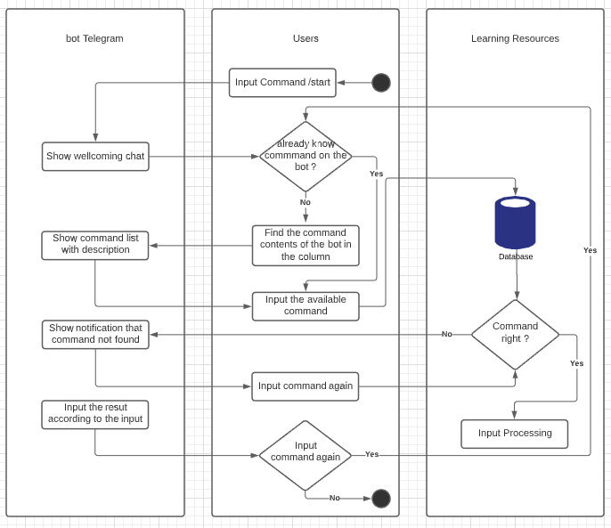

Slide 13
Objectives
5.1 Provide Information
The primary objective of Loan Pal is to offer comprehensive and accurate information about various loan schemes.
Users should be able to inquire about different loan types, eligibility criteria, interest rates, application procedures, and repayment terms.
5.2 Guide Users through Loan Application
The chatbot will assist users in the loan application process.
This involves collecting necessary information, directing users to the appropriate application forms, and providing guidance on the submission process
5.3 Answer User Queries
Loan Pal can effectively and efficiently responds to user inquiries, providing prompt and helpful answers to questions related to loan schemes.

Slide 14
System Design & Implementation
1. Requirements Gathering : Detailed user research, interviews, and analysis of user expectations to define the complexity of the loan process and user preferences.
2. Design and Architecture : Careful preparation of the chatbot structure, user interface, dialogue, and backend process using Python and NLP technologies such as NLTK or spaCy .
3. Development : Development of the chatbot using Python and machine learning algorithms to understand user requests and provide personalized loan recommendations.
4. Testing : Comprehensive testing to identify and fix problems with functionality, accuracy, and usability.
5. Deployment : Deployment of the chatbot to various platforms such as web and mobile applications using Python-compatible deployment tools.
6. Maintenance and Updates : Continuous monitoring of user feedback to implement updates and improvements to the chatbot algorithm and .user interface using Agile development methods

Slide 15
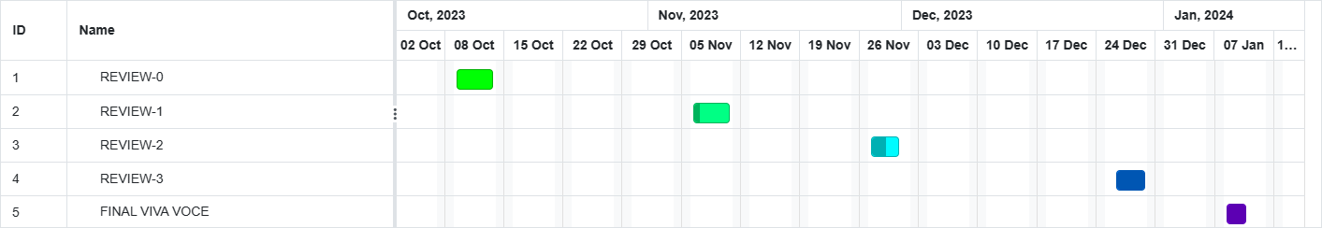
Timeline of Project

Slide 16
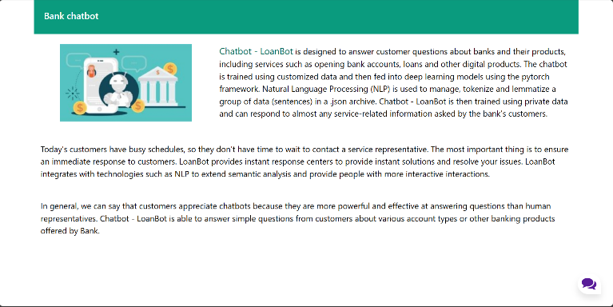
Outcomes / Results Obtained
Home Page:

Slide 17
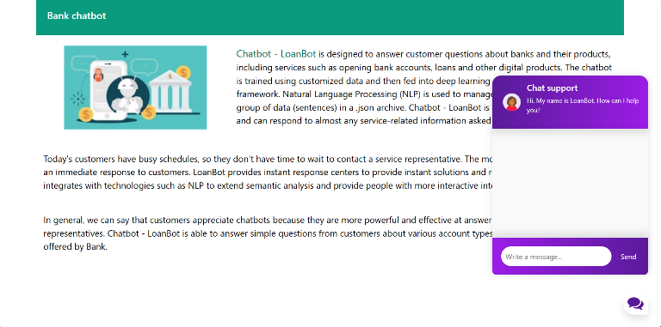
Chatbot Page:

Slide 18
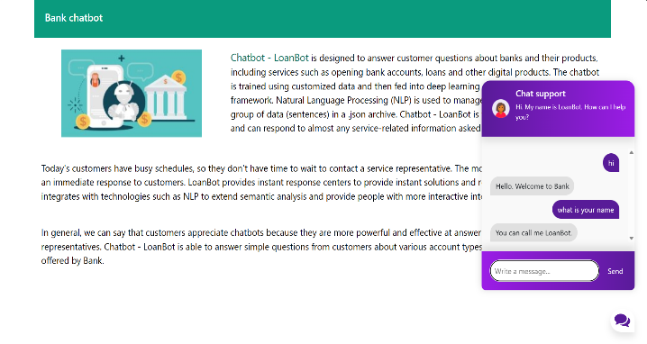
Chatbot interaction

Slide 19
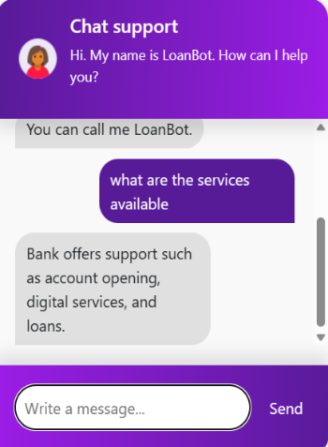
Result 1:

Slide 20
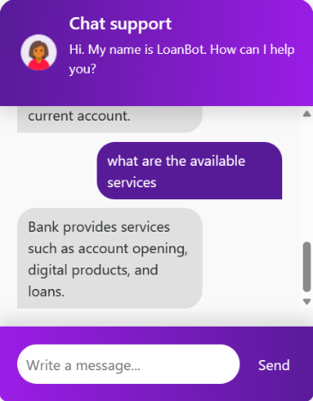
Result 2:

Slide 21
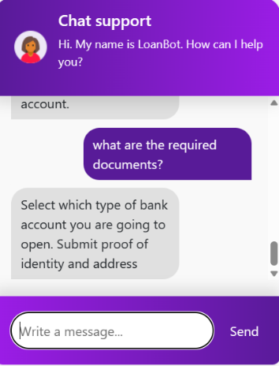
Result 3:

Slide 22
Conclusion
In conclusion, the development and deployment of the Loan Bot mark a significant leap forward in leveraging technology to streamline the dissemination of financial information, particularly within the domain of government loan schemes. The integration of Natural Language Processing (NLP) and machine learning empowers the chatbot to intelligently comprehend and respond to user queries, providing a user-friendly alternative to conventional methods of obtaining loan-related information.
The primary objective of the Loan Bot is to enhance user convenience by saving time through the delivery of prompt and accurate responses to user queries. This not only contributes to the overall efficiency of the loan application process but also establishes the chatbot as a reliable tool in facilitating seamless interactions. Through the continuous application of machine learning techniques, the chatbot refines its understanding and response patterns, ensuring adaptability and precision in its interactions with users.
The document underscores key principles such as transparency, user trust, and compliance with regulatory standards. It emphasizes the importance of continuous improvement, multi-channel integration, and user education in financial literacy as essential elements for evolving the Loan Bot into a sophisticated and user-centric tool.

Slide 23
Looking towards the future, the direction of work for the Loan Bot includes refining natural language understanding, sentiment analysis, entity recognition, and intent classification. Additionally, there will be a focus on developing machine learning algorithms for dynamic and personalized loan recommendations, risk assessment, and fraud detection. These advancements aim to further enhance user interaction and ensure the security and reliability of loan processes.
In summary, the Loan Bot exemplifies the transformative potential of NLP and machine learning-powered chatbots in reshaping how individuals engage with financial services. It prioritizes precision, efficiency, and user satisfaction, setting the stage for continued advancements in the realm of financial assistance and information dissemination.

Slide 24
References
[1] Yingying Gao and Marijn Janssen. 2020. Generating value from government data using AI: An exploratory study. In 19th IFIP WG 8.5 International Conference on Electronic Government. Springer, 319–331.
[2] Rizk, Y., Isahagian, V., Boag, S., Khazaeni, Y., Unuvar, M.,Muthusamy, V. and Khalaf, R., 2020, September. A Conversational Digital Assistant for Intelligent Process Automation. In International Conference on Business Process Management (pp. 85-100).
[3] Adamopoulou, Eleni, and Lefteris Moussiades. “An overview of chatbot technology.” IFIP International Conference on Artificial Intelligence Applications and Innovations. Springer, Cham, vol. 584, 2020.
[4] O. Hourrane, H. Ouchra, A. Hafsa, EL. Eddaoui, H. Benlahmar and O. Zahour, "Towards a Chatbot for educational and vocational guidance in Morocco: Chatbot E-Orientation", International Journal of Advanced Trends in Computer Science and Engineering, vol. 9, no. 2, pp. 2479-2487, April 2020.
[5] R. Rajkumar and V. Ganapathy, "Bio-Inspiring Learning Style Chatbot Inventory Using Brain Computing Interface to Increase the Efficiency of E-Learning", IEEE Access, vol. 8, pp. 67377-67395, 2020.

Slide 25
[6] M. Dharani, J. V. S. L. Jyostna, E. Sucharitha, R. Likitha and S. Manne, "Interactive Transport Enquiry with AI Chatbot", 2020 4th International Conference on Intelligent Computing and Control Systems (ICICCS), pp. 1271-1276, 2020.
[7] Ramires Hernández P, Valle-Cruz D and Mendoza Méndez R.(2022). Review on the Application of Artificial Intelligence-Based Chatbots in Public Administration. Handbook of Research on Applied Artificial Intelligence and Robotics for Government Processes. 10.4018/978-1-6684-5624-8.ch007. (133-155).
[8] Collins, Coty M. “Chatbot development and deployment platform.” US Patent No. 10,817,265. October 27 2020.
[9] Muhammad, Aliv Faizal, et al. “Developing English Conversation Chatbot Using Dialogflow.” 2020 International Electronics Symposium (IES). IEEE, pp. 468–475, 2020.
[10] Sharma, Rakesh Kumar, and Manoj Joshi. “An Analytical Study and Review of open Source Chatbot framework, RASA.” International Journal of Engineering Research and , vol.9, no.06 (2020).

Slide 26
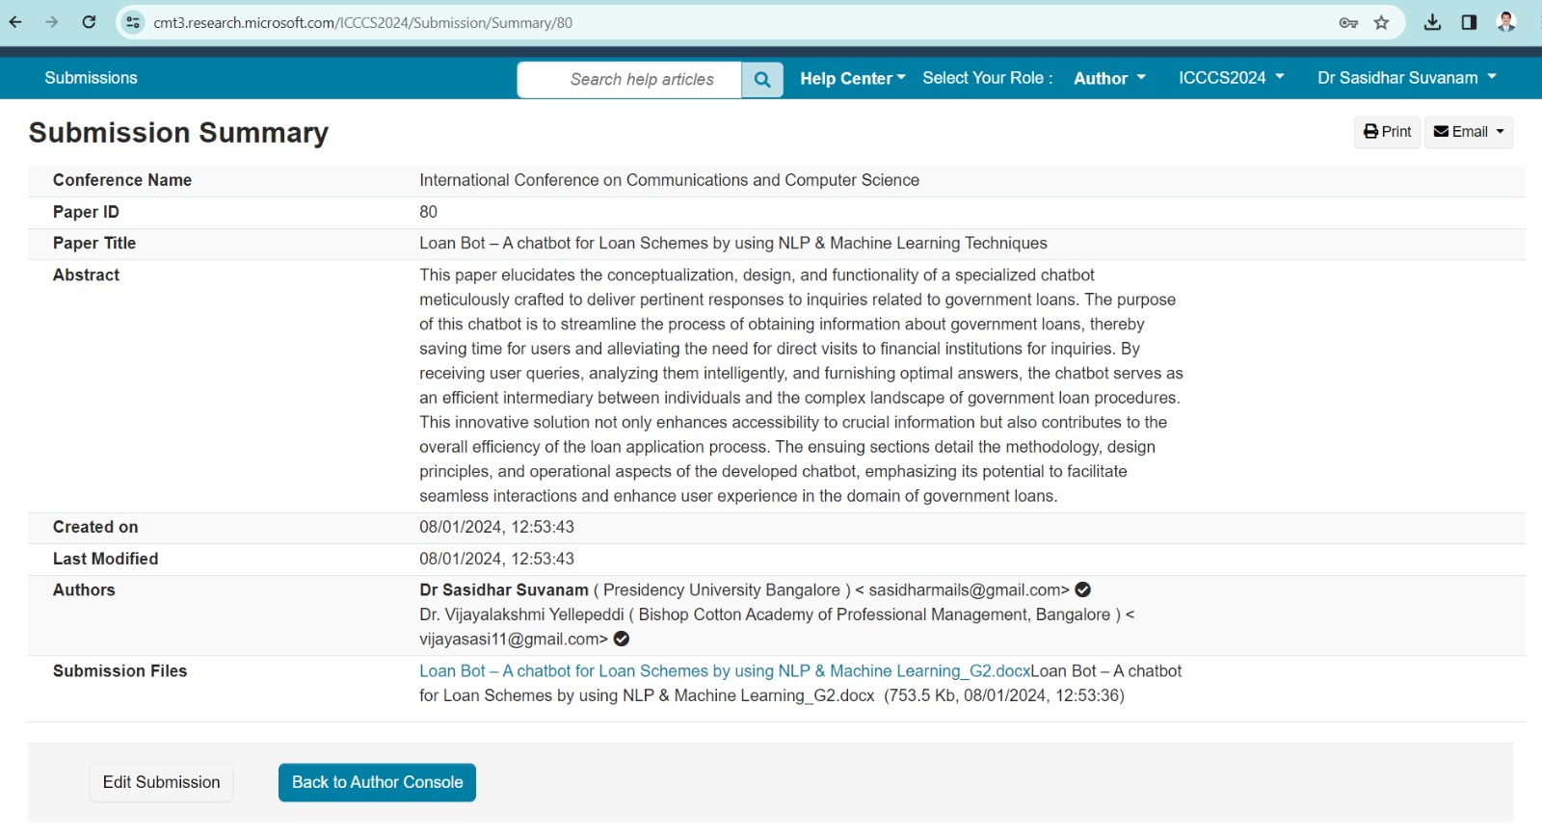
Publication Details

Slide 27

Thank You

